Slide 1
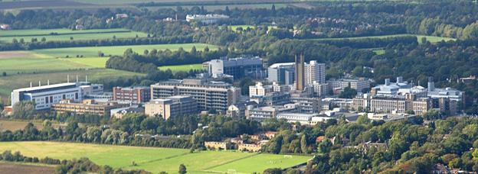
Pathophysiology of Stone disease: recent advances in the light of endoscopic evaluation of the papillae ?
Samih Al-Hayek
LRCP (Lond), LRCS (Eng), LMSSA (Lond), MRCS, MD, FRCS (Urol)
Consultant Urological Surgeon & Associate Lecturer
Cambridge University Hospitals, UK
Turkish Urology Academy, Trabzon 7 Sep 2019

Slide 2
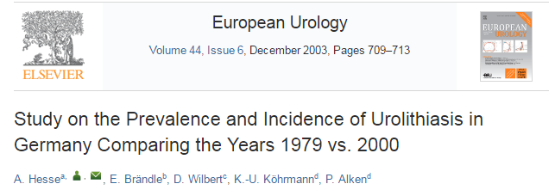
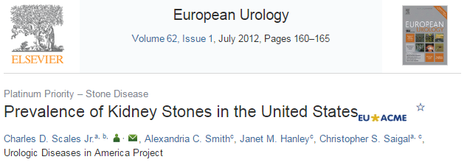
Prevalence & Incidence
N = 7500
Prevalence ♂ 5.5%, ♀ 4.0%, Overall 4.7%
Incidence ♂ 0.84%, ♀ 0.63%, Overall 1.47%
Recurrence rate = 42%
Other studies 35-50%
NHANES survey, N = 12,110
Prevalence ♂ 10.6%, ♀ 7.1%, Overall 8.8%
Incidence ♂ 0.84%, ♀ 0.63%, Overall 1.47%

Slide 3
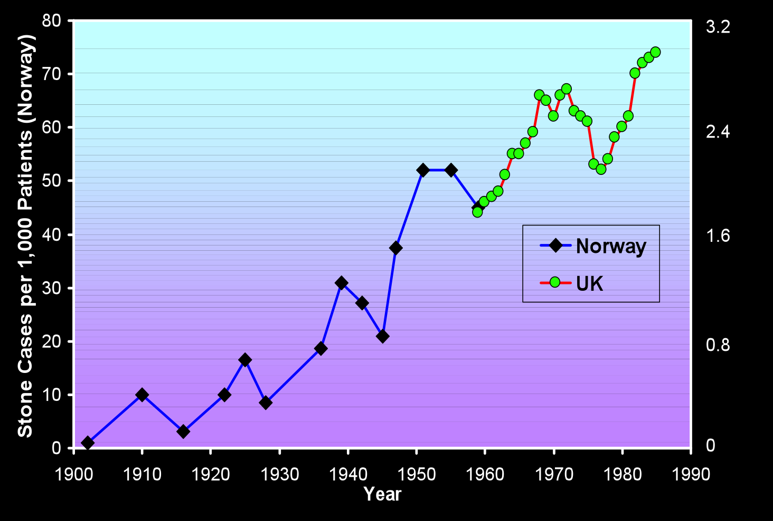

Slide 4
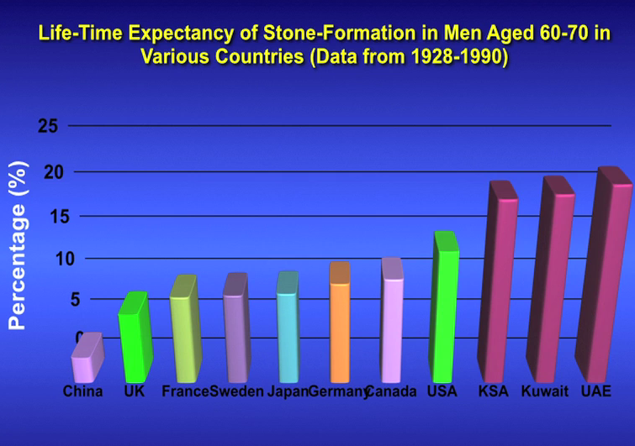
Courtesy W Robertson

Slide 5

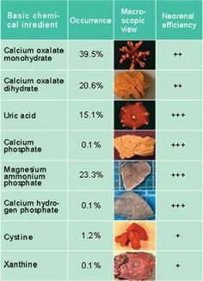
Stone analysis
Notes:
Westbury, BJU 1974

Slide 6
Formation Theories

Slide 7
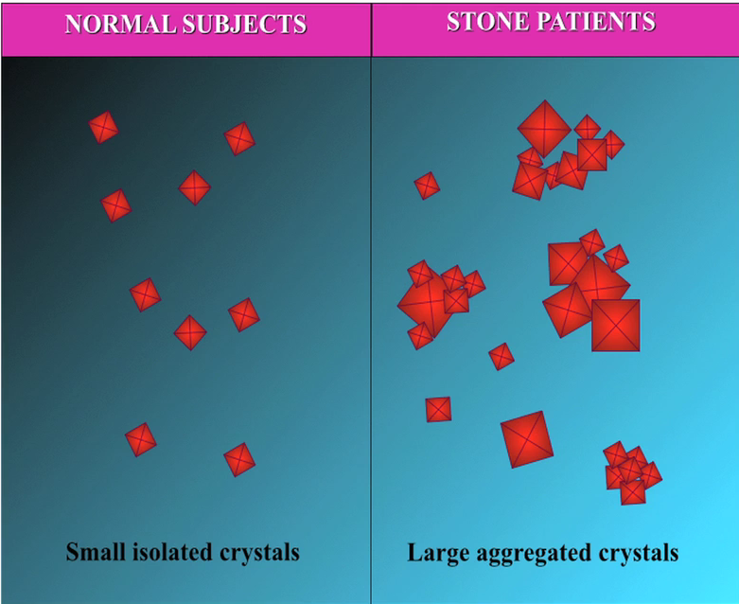

Slide 8
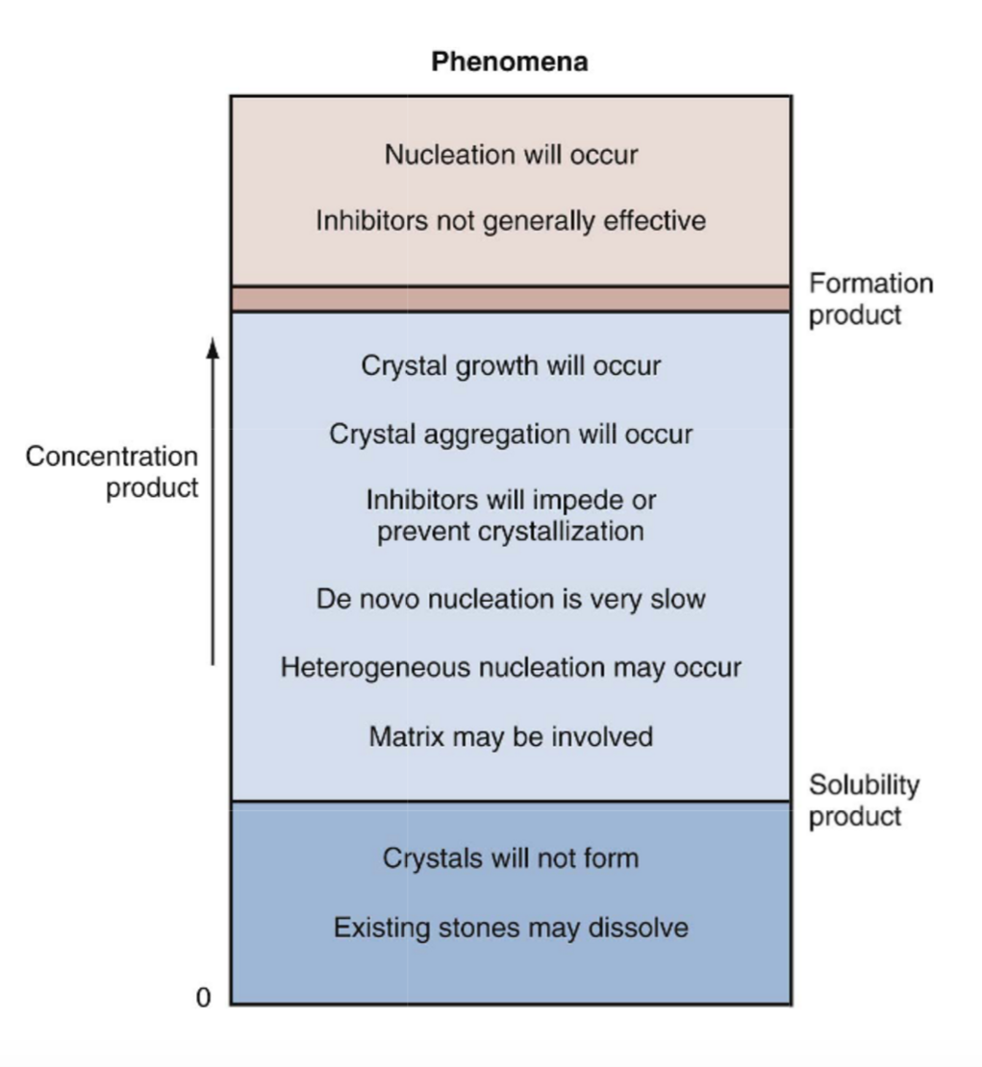
Supersaturation
Unstable
Metastable
Undersaturated

Slide 9
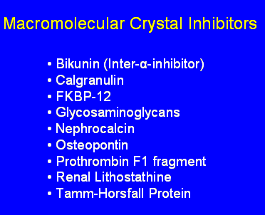
Lack of Inhibitors
Organic
  -mucoproteins (may coat crystals)
  -peptides (nephrocalcin)
  -citrate
Inorganic
  -phosphates
  -Mg

Slide 11
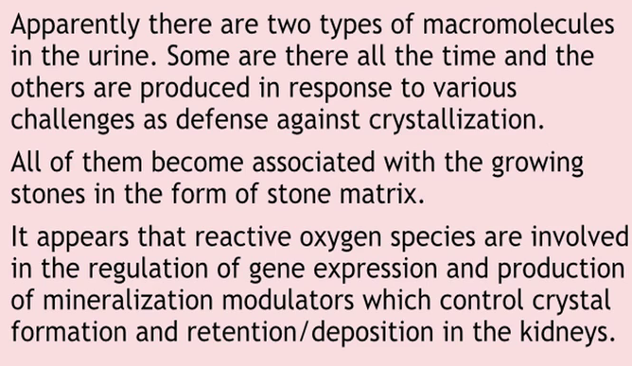
Stone Matrix S Khan

Slide 12
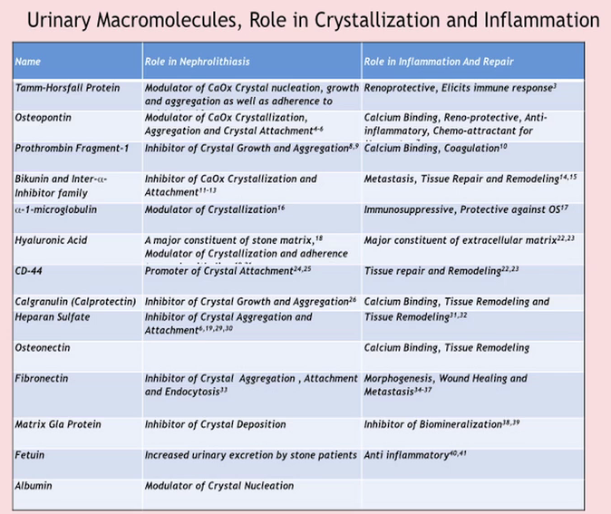

Slide 13
Free vs Fixed Particles theories?
Free particle crystal growth theory
  “Nuclei and crystals can grow in supersaturated urine during transit through nephron”

Slide 14


Slide 15
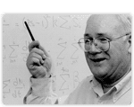
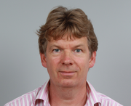
Free vs Fixed Crystals?
Free particle crystal growth theory
  “Nuclei and crystals can grow in supersaturated during urinary transit through nephron”
  Fixed particles crystalization is prerequisite for stone formation
  “…We conclude that stone disease in the renal tubules and renal pelvis cannot begin on unattached (free) particles.” Finlayson et al, 1978
HOWEVER
  “…During the normal transit time through the kidney, crystalline particles can be formed which are large enough to be retained…and form the nidus of a stone.” DJ Kok, Khan, 1994

Slide 16
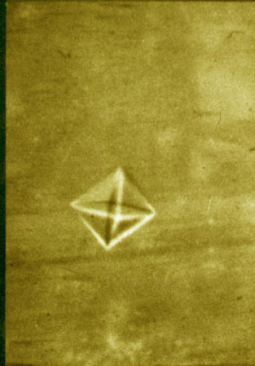
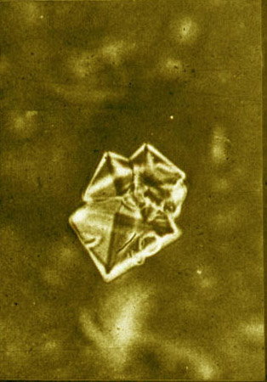
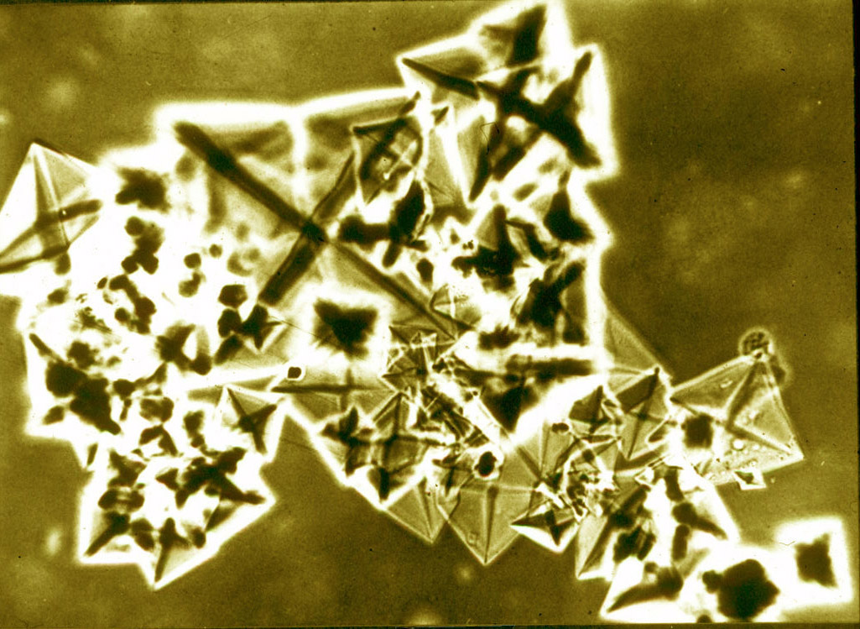
Free Particle Ca Ox
Crystal nucleation: Promoted by low urine volume and citrate, and high urinary calcium/oxalate/uric acid/phosphate
Crystal growth and agglomeration: Inhibitors prevent process
Retention of critically-sized particle
Growth of trapped particle into stone example Ca Ox

Slide 17
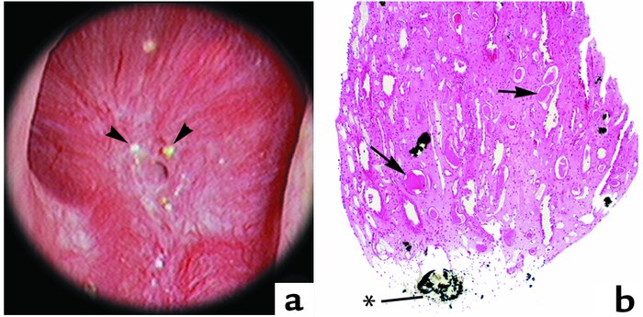
Randall’ Plaques
Randall’s plaques – subepithelial plaques on renal papillae
Randalls plaques present in 74% stone formers, 43% controls Low and Stoller, 1997
Mostly calcium phosphate

Slide 18
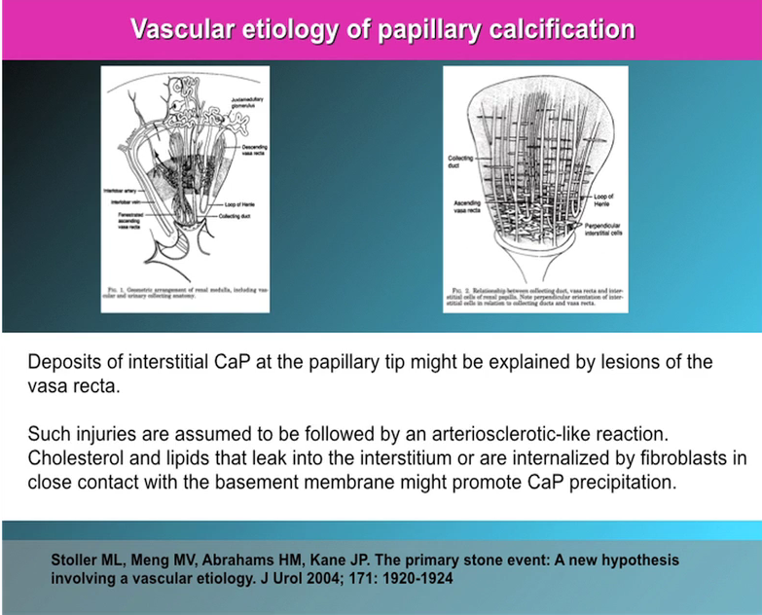

Slide 19
New advances
HD and digital
Endoscope
Micro CT imaging

Slide 20
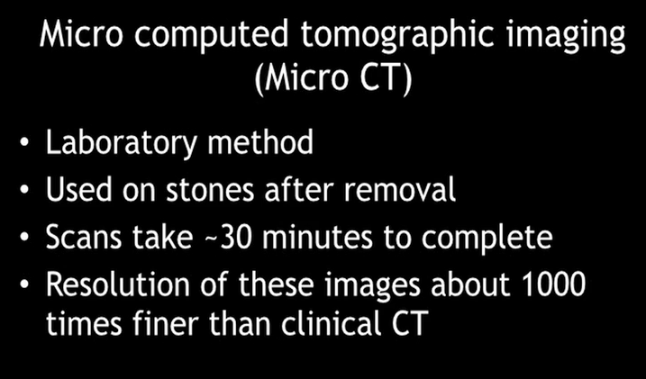
Courtesy J Williams
Notes:
Apatite: calcium phosphate
Micro CT images of Bellini Duct plugs with overgrowth
Opening of the BD dotted

Slide 21
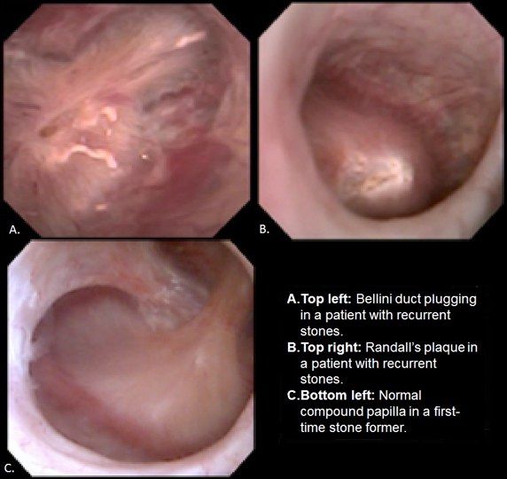
Courtesy J Williams
Notes:
Digital scopes

Slide 22
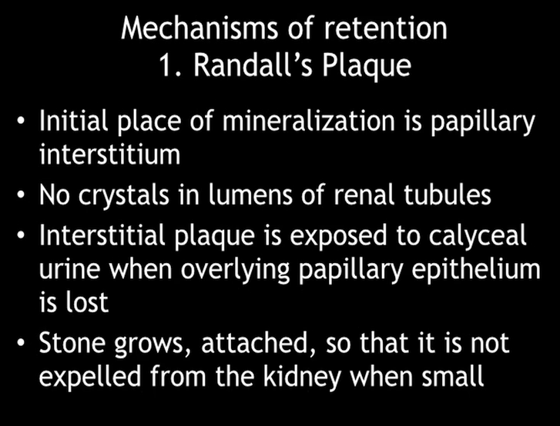

Slide 23
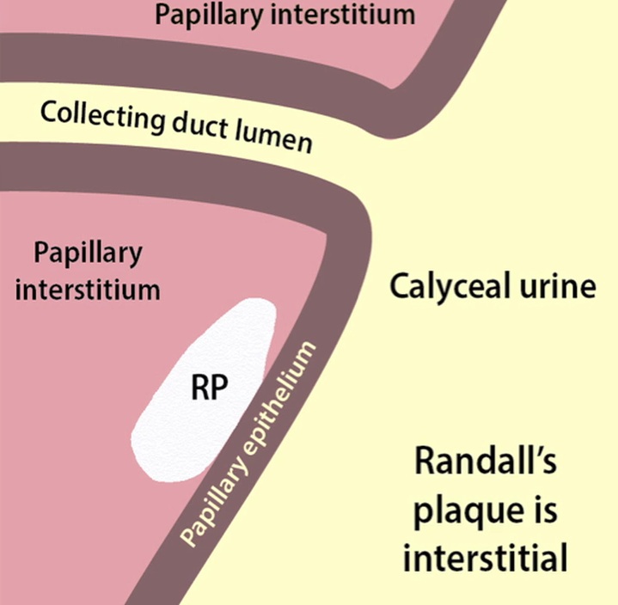
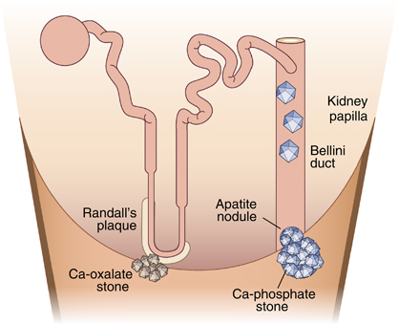
Courtesy J Williams

Slide 24
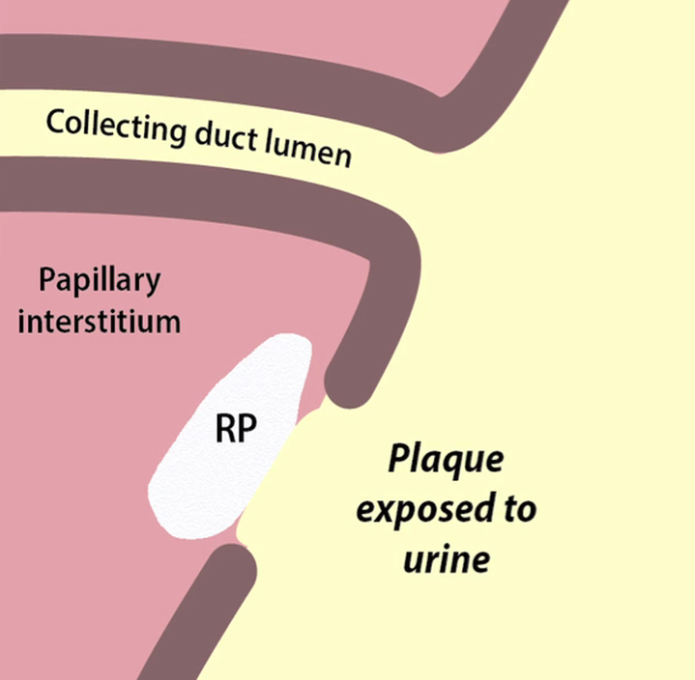
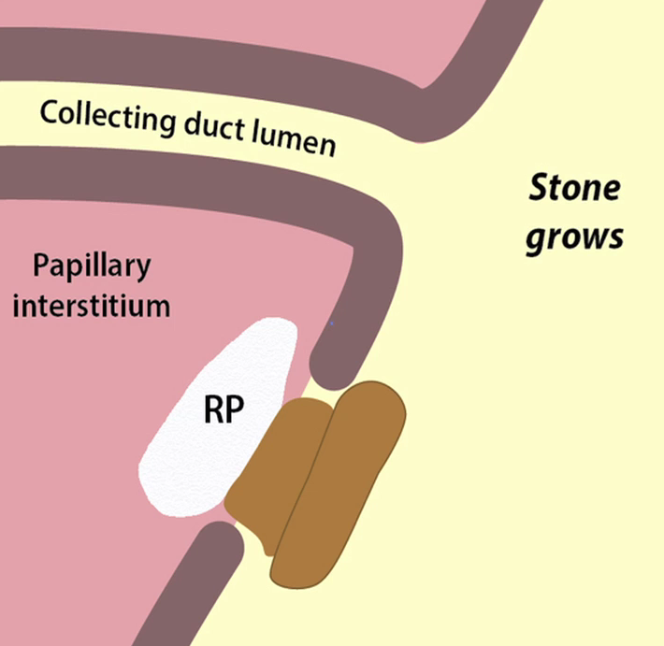
Courtesy J Williams

Slide 25
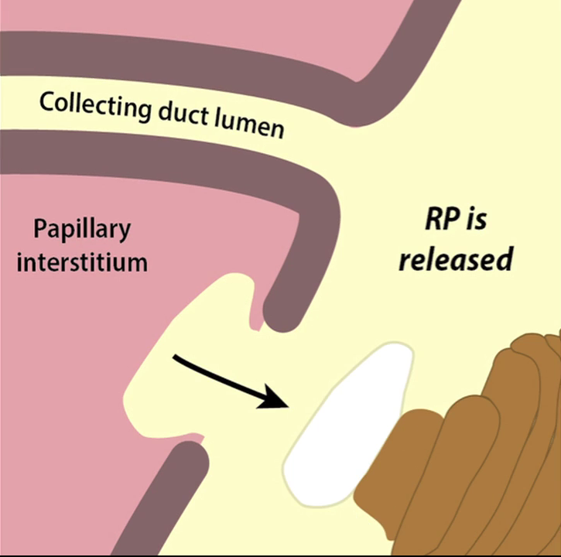
Courtesy J Williams

Slide 26
Notes:
Usually calcium oxalate stones anchor onto the Randall’s plaque

Slide 27
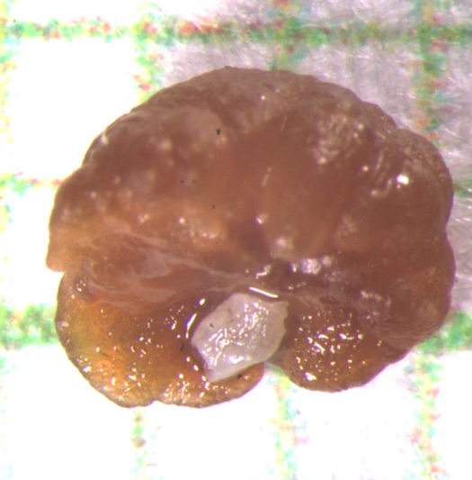

Slide 28
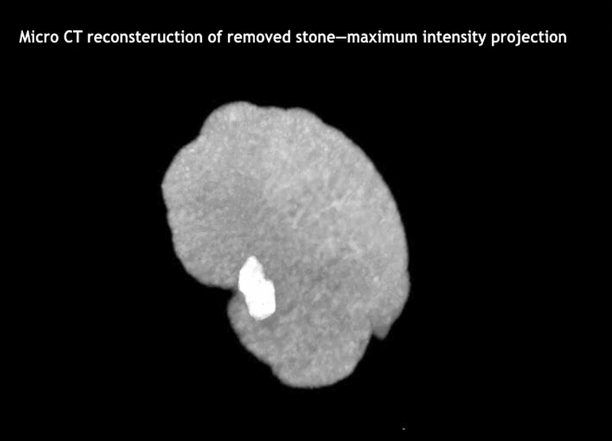
Courtesy J Williams

Slide 29
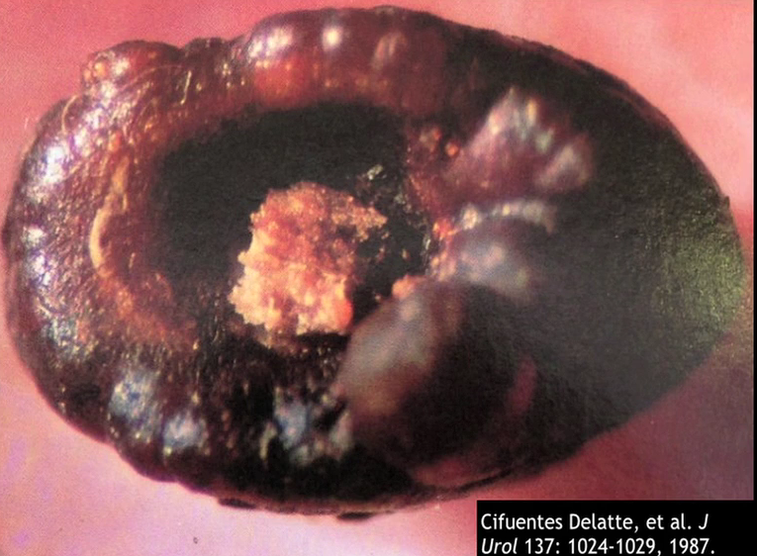
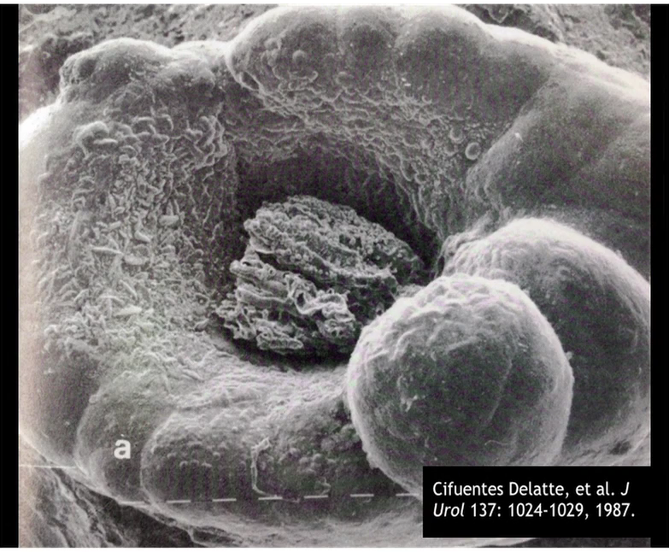

Slide 30
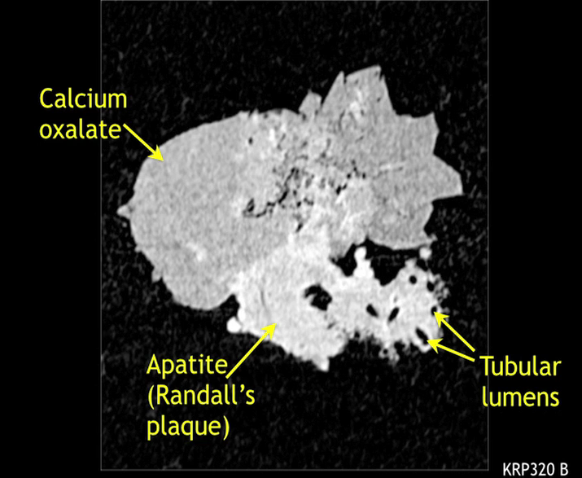

Slide 31
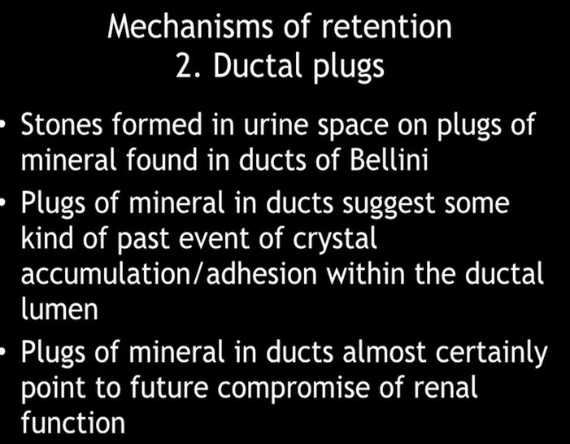
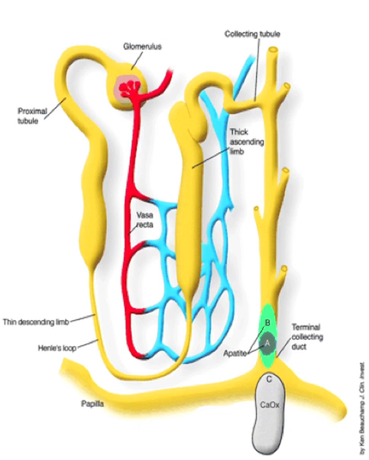

Slide 32
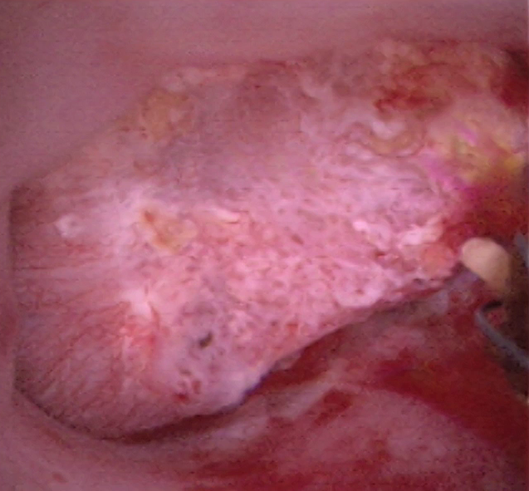
Courtesy J Williams

Slide 33
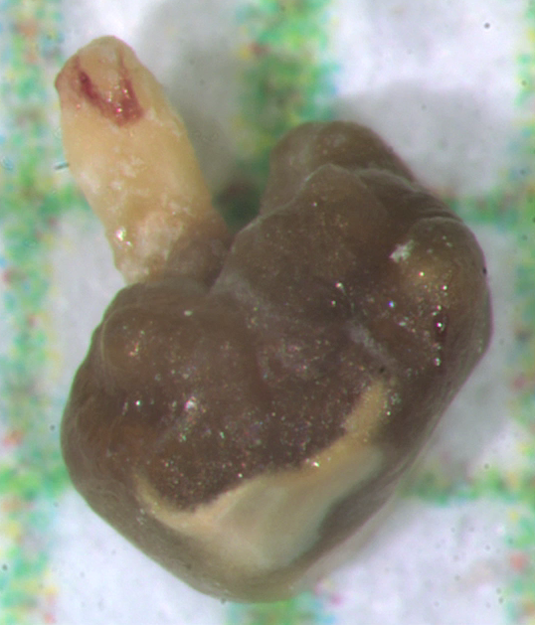
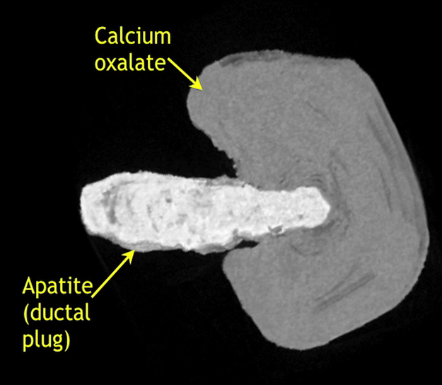

Slide 34
Plugging
Why do ductal plugs form
Why are they different to the stone composed in calcyeal urine
Why some breaks away and others don’t

Slide 35
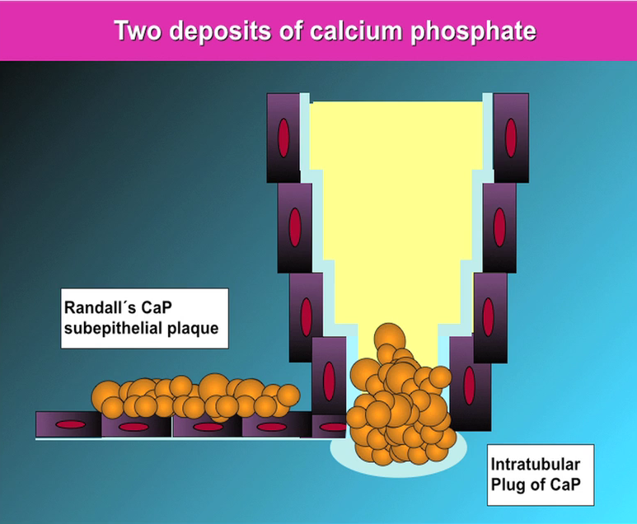
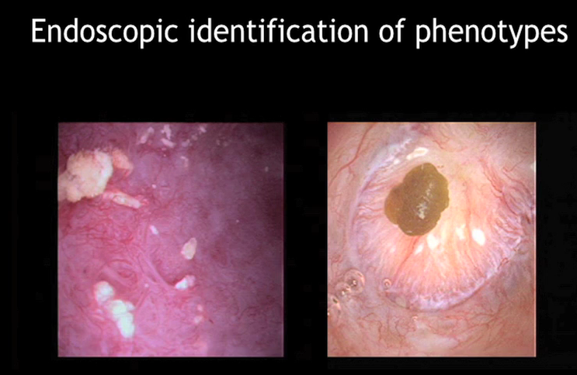

Slide 36
Notes:
Pitting= σκασίματα
342 pts
0a to 6c the worse

Slide 37
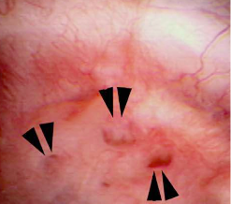
PAPILLARY MALFORMATIONS
Ductal dilatation
Notes:
Normally 300-600 microns (multiple diameter)

Slide 38
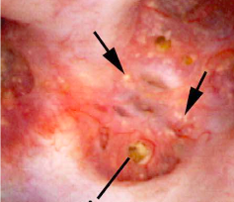
PAPILLARY MALFORMATIONS
Ductal plugging: Crystal in the ducts injure the cells, less acidic urine more calcium phosphate stones
Notes:
Yellow mineral deposits protruding from dilated Bellini ducts
Crystal in the ducts injure the cells, less acidic urine more calcium phosphate stones (above 6.2)

Slide 39
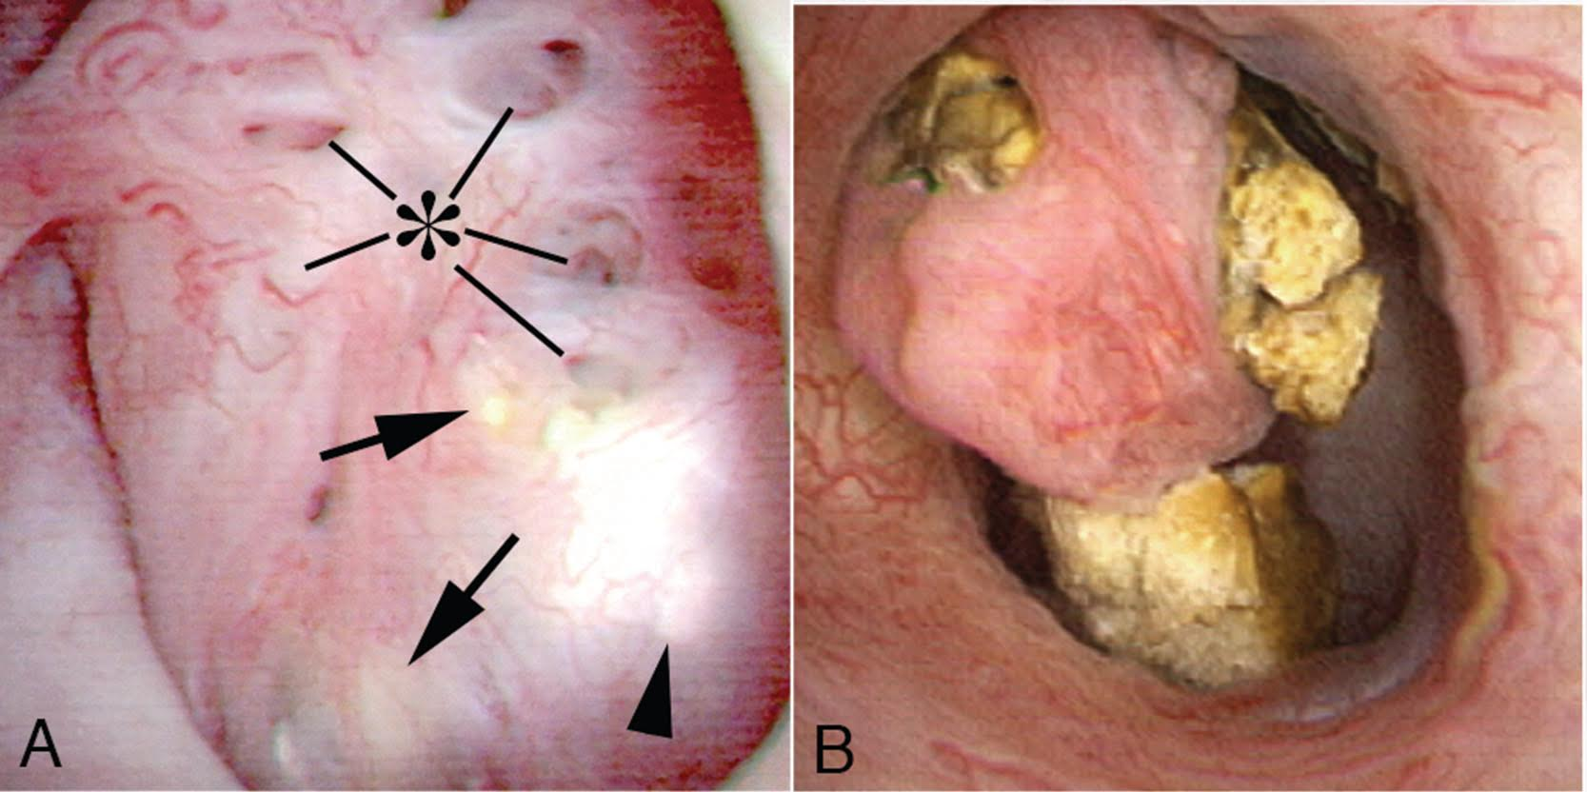
PAPILLARY MALFORMATIONS
Medullary Sponge Kidney (MSK)
Tubular plugging. Enlarged, rounded papilla due to the plugging
Laser De-roofing
Courtesy J Williams
Notes:
Tubular plugging
Enlarged, rounded papilla due to the plugging
Laser unroofing

Slide 40
CONCLUSIONS
Several possible theories for stones formation: supersaturation, inflammation, fixed and free particles, vascular, Randall’s plaques, plugging …
Stones formation is multi-factorial
Stone analysis might direct to specific risk factors to help prevent further stones
Renal papillae appearance during endoscopey might correlate with the mechanisms of stones formation and composition
Randall’s plaque amount, plugging, pitting and loss of contour can be described with a grading system during digital flexible endoscopy with possible risk stratification
Notes:
Measurable reproducible manner

Slide 41
acknowledgments
James Williams
Hans-Goran Tiselius
Jose Reis Santos
William Robertson
S Khan

Slide 42
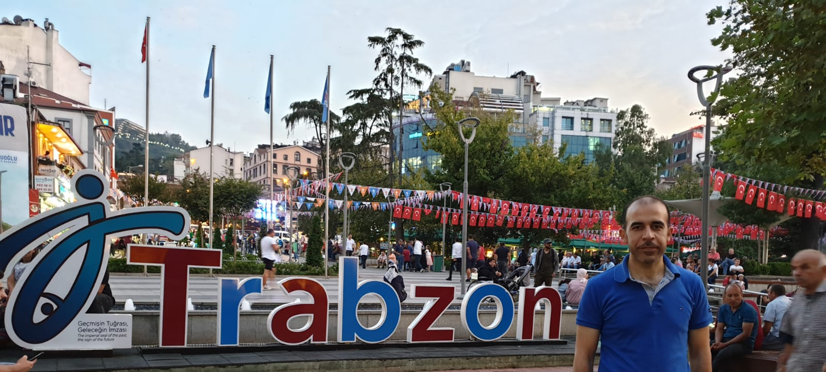
Thank you

Slide 43

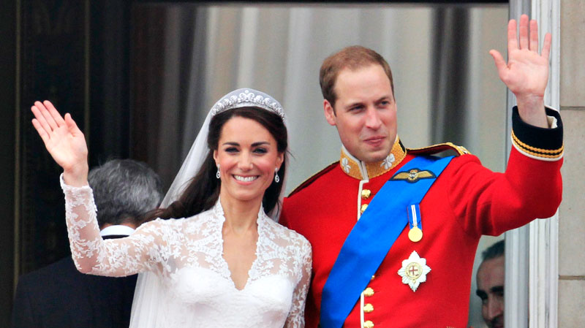
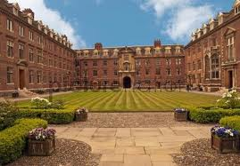
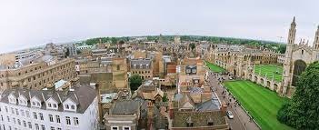
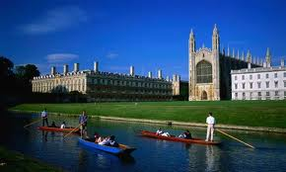
Thank You
Duke and Duchess of Cambridge

